Slide 1

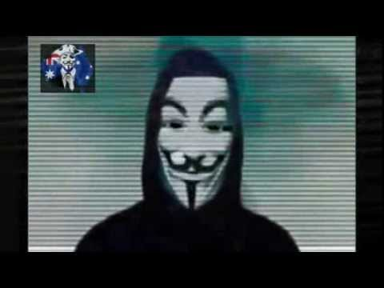


Anonymous Internet Browsing by Collin Donaldson

Slide 2
Outline
Overview
Definitions and Explanations
Part 1: How it all works
Overview of Network Communication
Overview of Network Traffic
Overview of Internet Browsing
Part 2: How to anonymize it
Private Browsing and beyond
DuckDuckGo
Proxies (Onion Routing) and VPN
Mobile Security
Sources

Slide 3
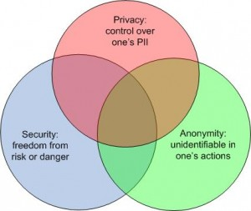
Definitions: Ideals Not Realities!

Slide 4
Privacy vs Security vs Anonymity
Privacy (P): “I control my information”.
Anonymity (A): “A third party cannot associate my information with me.”
Security (S): “My information is safe from interference (harm)”.
Not mutually exclusive
Can be combined (protection in depth)
Single point of failure: the human

Slide 5
Hypothetical Example
A video file (VF) resides in your computer.
Assume the computer is always offline, is immune to digital forensics, and can only be accessed by you.
VF: S, P, A
You allow others to use your computer.
VF: !S, !P, !A
You encrypt the file (homebrew)
VF: S, !P, !A
You implement user control, others cannot access the file
VF: S, P, !A
You hide the file from other users
VF: S, P, A

Slide 6
The Problem
Networks greatly complicate security, privacy, and anonymity
A known (not anonymous) file breaches privacy and risks security
A non-private file breaches anonymity and risks security
An insecure file risks privacy and anonymity
Uploading that video file from the previous example to a website like YouTube throws anonymity right out the window

Slide 7

Crash Course in how Networks and Internet Browsers Work!

Slide 8
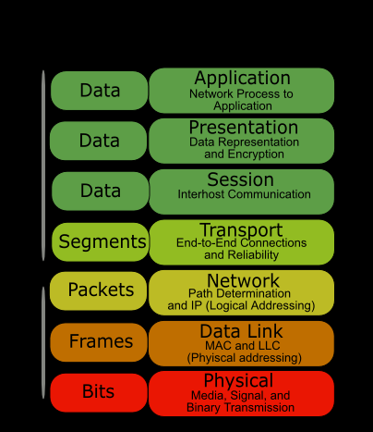
Network Communication: The Open Systems Interconnect (OSI) Model

Slide 9
NOTE!!!!
This presentation will focus on the Application, Presentation, Session, Transport, and Network Layers.
The Data Link and Physical Layers are beyond the scope of this presentation, but are still important!
For example: Companies like Verizon and AT&T have been caught using Unique Identifier Headers (UIDHs) which act like “permanent cookies” via all 7 layers.

Slide 10
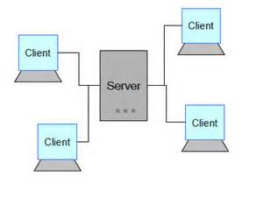
Client-Server Model

Slide 11
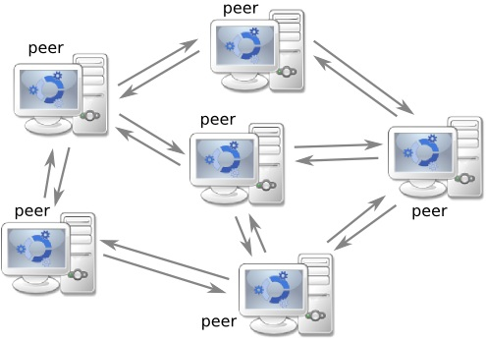
Peer to Peer (P2P)

Slide 12
Network (IP) Traffic
Transport Control Protocol (TCP)
User Datagram Protocol (UDP)
Ex: HTTP, FTP, SMTP
Connection oriented
Reliability > Speed
Heavyweight (requires 3-way handshake)
Usage: Small Data
Target Practice Analogy:
Stop and Pop
Ex: DNS, DHCP, VOIP
Connection-less
Speed > Reliability
Lightweight (no handshake)
Usage: Big Data
Target Practice Analogy:
Spray and Pray

Slide 13
Web Browsers and the Internet
1. Your web browser is a client that allows you to access the world’s largest server, the internet.
2. The internet uses a service called the World Wide Web to make it easy for clients (browsers) to view its content.
URLS, IP addresses, search engines (web crawlers), etc.
3. Web browsers display information by interpreting HTML references accessed via the internet. The HTML acts as pointers to the information you actually want to access.
4. The HTML’s coding tells the browser how to interpret the information (i.e. file format)
5. Browsers need to be configured with plugins to view certain kinds of information.
Ex: Adobe Flash, Active X, Java, JavaScript, etc.
6. Previous information is stored on your browser for future easy access (cookies, history, etc. ).

Slide 14
Private Browsing
Unlike normal browsing, no information is stored about you
Private Sessions are “sandboxed” from normal sessions
Plugins may or not be private
Still vulnerable to:
Search engines
Websites that collect/share info about you (read: most websites)
Malware
Internet Service Provider (ISP) surveillance
Physical surveillance

Slide 15
Private Browsing++
NoScript: Control exactly what scripts (plugins) run on your computer
AdBlock Plus: Keep ads and adware from executing on your computer
Abine’s Blur: Anti-Trackers, Autogenerated Proxy Email Addresses, Passwords, and Credit Card Numbers,
ShodanHQ and ScamAdvisor.com: Check where a website is and if it is legitimate.
CCleaner and others: Customizable local data management

Slide 16

DuckDuckGo
https://www.youtube.com/watch?v=GJ-5A9xqxBY\
ZERO Data Collection
Less Spam
Faster results
Uses Google’s Monopoly Against It
Sponsors:
Mozilla Firefox
Apple Safari
Microsoft Bing
Yahoo Search
Tor Foundation
And Many More!

Slide 17
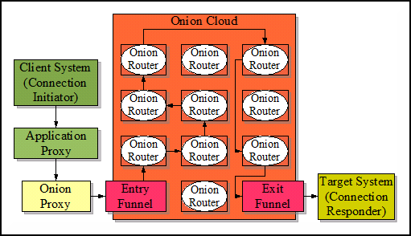
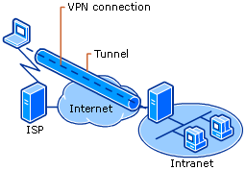
Proxies vs Virtual Private Networks
Proxies (Tor)
VPN

Slide 18
Onion Routing and VPN
Onion Routing
VPN
Free!
Main Architecture: P2P
Do It yourself
Priority: Privacy and Anonymity
Protocol: All TCP (effects speed)
$$$
Main Architecture: Client-Server
Generally All-In-One (commercial)
Priority: Security and Privacy
Protocol: TCP and UDP

Slide 19
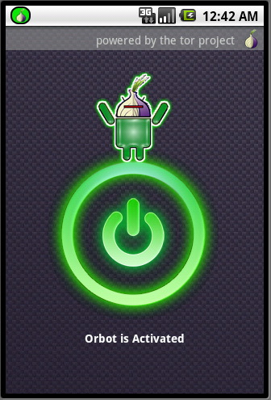
Mobile Anonymity
Anonymity does not automatically transfer to mobile devices!
You have to manually configure everything again…..
Browsers: DuckDuckGo (or configure others browsers)
Proxy: Orbot
VPN: OpenVPN
Root/Jailbreak for full control!

Slide 20
Sources (URLS and titles)
Computer Networks: A Top Down Approach (Pearson, everything, especially Ch.18 how web browsers work)
https://www.torproject.org/about/overview.html.en (Tor)
http://technet.microsoft.com/en-us/library/cc779919%28v=WS.10%29.aspx (VPNs)
http://www.howtogeek.com/117776/htg-explains-how-private-browsing-works-and-why-it-doesnt-offer-complete-privacy/?PageSpeed=noscript (Private Browsing)
http://support.microsoft.com/kb/103884 (OSI model)
http://www.diffen.com/difference/TCP_vs_UDP (TCP/UDP)
http://www.wired.com/2014/10/verizons-perma-cookie/ (UIDHs)
https://duckduckgo.com/ (Research and DDG info)
https://www.youtube.com/watch?v=GJ-5A9xqxBY (YouTube, DDG, Open Labs)

Slide 21
Sources (Images and titles)
http://www.concurringopinions.com/wp-content/uploads/2011/01/privacy-security-anon1-300x253.jpg (Venn Diagram)
http://4.bp.blogspot.com/-CUGfaG1zGzQ/Td4NpWHPKBI/AAAAAAAAAC8/G2TbB88zzDY/s1600/osi-model-7-layers.png (OSI)
http://media-cache-ec0.pinimg.com/736x/ae/46/a5/ae46a5f95b9ce1d30f0b130aa4b5b257.jpg (NSA eyeball)
http://www.caribbeanbusinesspr.com/fotos/cyber-soldier.jpg (Cyber soldier)
http://img.youtube.com/vi/70Iqb7v89Vg/0.jpg (Anonymous guy)
http://www.game-en-co.nl/wp-content/uploads/2013/02/watch_dogs_wallpaper_by_neosayayin-d563o6l.jpg Watchdogs wallpaper
http://www.crash-course.org.uk/wp-content/uploads/2012/12/Crash-Course-logo-new.jpg (Crash Course)
http://www.chequeprinting.net/manual/server-client-setup.php (Client-Server)
http://ten7023.patrickplante.org/archives/247 (DuckDuckGo)
http://ntrg.cs.tcd.ie/undergrad/4ba2.05/group10/index.html (Onion Routing)
https://guardianproject.info/wp-content/uploads/2010/03/orbot-on.jpg (Orbot)
http://toniinfo.com/wp-content/uploads/2010/08/p2p.jpg (P2P)

